Slide 1


Behavioral Analysis for digital strategy: Exercise & Fitness
Team 8
May 03, 2023

Slide 2







Team 8
Data Preprocessing
Preprocess to filter our category based on terms: Exercise, Fitness, Gym, Health, Yoga, Workout, Fitness Equipment, Nutrition, Pre-defined: (Sports & Outdoors, Shoes).
Filter Category
1140 Purchases​
590 Unique Users​
While considering 6 hours before & after Purchase​
1481 related media behavior​
1736 related visits​
5202 social behavior records​
Converting Timestamps
Results
Irrelevant Columns
Redundancy & Missing Data
Analysis
Hierarchy
Digital Footprint
Top Retailers
Advertisement
Recommendation

Slide 3

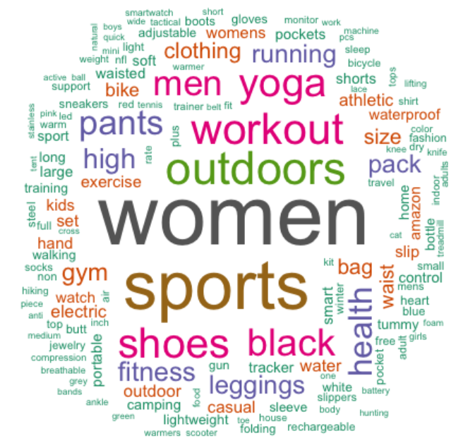

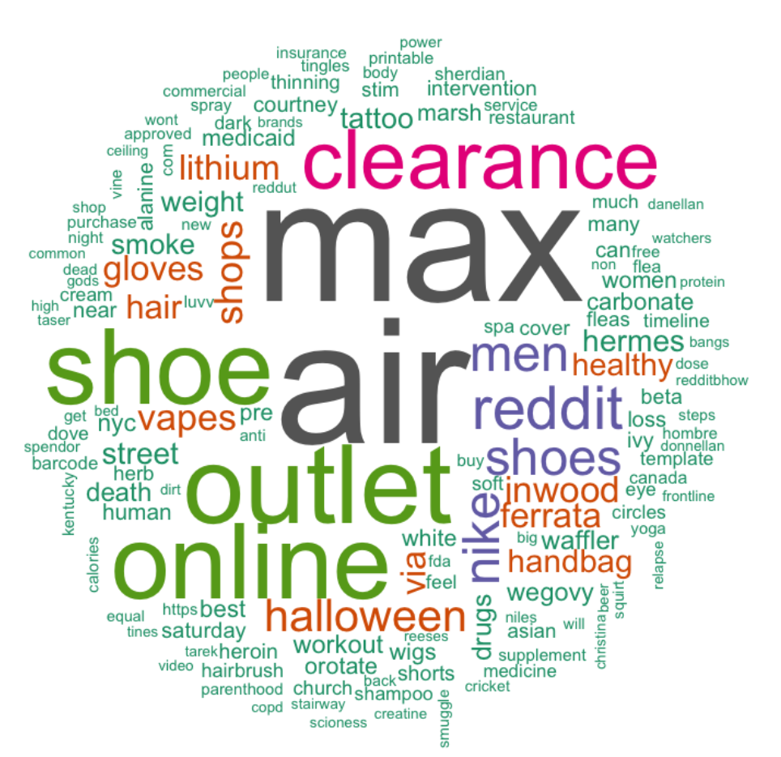
Search Terms Analysis for SEO strategy
Team 8
Shopper Data
Web Data
Added to Basket
Purchased
Analysis
Hierarchy
Digital Footprint
Top Retailers
Advertisement
Recommendation

Slide 4


Team 8
Purchase Journey and Decision Hierarchy
PURCHASE Journey
Amongst the panelist who purchased product from this category
419
Repeat customers
84
Customers who directly purchase after viewing
Amazon brands account for 30% of advertisers
Samsung was the most common brand of smartphone owned followed by Motorola
Games-RPG/Simulation was the most popular app category, with other Games categories like Puzzle/Trivia, Card/Board/Casino being highly used
~12% average conversion rate
Super Users:
~90% products bought on the same day as viewed
In case of gap, product might be bought within a day or more than a month later from when viewed (avg: ~17days)
45
users (>=5 purchases) account for 30% purchases
Only ~10% users are searching about the product on web prior to purchasing
~6% median conversion rate
Note: The data for search terms had a lot of missing values. Given the category, the number of indirect searches can be significant (which do not have product name but product related benefits)
Analysis
Hierarchy
Digital Footprint
Top Retailers
Advertisement
Recommendation
Notes:
Edit pie remove left hand side chart

Slide 5
Appendix I
Team 8
To understand Top Shopped Retailers and Digital Traffic
By App
appname | count_app
Amazon Shopping | 70,259
Walmart Shopping Grocery | 18,329
Fetch Rewards Earn Gift Cards | 8,005
Temu | 7,925
Ad It Up Play Get Rewards | 7,333
Qmee Paid Surveys for Cash | 6,768
eBay The shopping marketplace | 5,770
Pogo Earn on Everything | 4,188
Ibotta Save Earn Cash Back | 3,993
Receipt Pal Scan Earn Rewards | 3,908
By Website
pagedomain | count_domain
amazon.com | 19,001
walmart.com | 6,094
rewards.bing.com | 3,416
etsy.com | 2,511
ebay.com | 2,030
temu.com | 1,516
walgreens.com | 1,340
target.com | 1,011
macys.com | 989
Bestbuy.com | 900
Digital traffic: purchasers and non-purchasers | visit_hrs
Amazon Prime | 1,553
Disney+ | 323
Netflix | 3,101
YouTube | 10,143
Amazon Prime_No | 8,171
Disney+_No | 2,776
Netflix_No | 26,632
YouTube_No | 134,285

Slide 6

Appendix II
Team 8
Total Application usage by Customer in our Category
Top Advertisers
Platform | Fitness Category | Total | Share
Amazon Shopping | 70,259 | 94,149 | 74.63%
Walmart Shopping Grocery | 18,329 | 46,895 | 39.09%
Fetch Rewards Earn Gift Cards | 8,005 | 34,774 | 23.02%
Temu | 7,925 | 20,607 | 38.46%
Ad It Up Play Get Rewards | 7,333 | 19,255 | 38.08%
Qmee Paid Surveys for Cash | 6,768 | 15,254 | 44.37%
eBay The shopping marketplace | 5,770 | 13,340 | 43.25%
Pogo Earn on Everything | 4,188 | 11,966 | 35.00%
Ibotta Save Earn Cash Back | 3,993 | 10,441 | 38.24%
Receipt Pal Scan Earn Rewards | 3,908 | 8,264 | 47.29%
Total | 136,478 | 274,945 | 0.49638
Advertiser | Number of ads | Share
TeePublic com | 196 | 15.0%
Amazon com | 151 | 11.6%
Amazon Fashion | 135 | 10.4%
Domino s Pizza | 112 | 8.6%
Walmart | 77 | 5.9%
Fun Break Central | 75 | 5.8%
Vitauthority | 64 | 4.9%
Amazon Home | 55 | 4.2%
SHEIN | 51 | 3.9%
Paramount | 51 | 3.9%

Slide 7
Appendix III
Team 8
Top App Categories
Top Manufacturers
App Category | Avg Time Spent (min) | Share
Games - RPG/Simulation | 15.61 | 29.3%
Games - Puzzle/Trivia | 7.24 | 13.6%
Beauty | 5.61 | 10.5%
Games - Card/Board/Casino | 4.69 | 8.8%
Shopping | 4.15 | 7.8%
Games - Action/Adventure/Arcade | 4.14 | 7.8%
Social Networking | 3.13 | 5.9%
Uncategorised | 2.93 | 5.5%
Photo & Video | 2.93 | 5.5%
Entertainment | 2.88 | 5.4%
Manufacturer | Count | Share
Samsung | 2372 | 54.3%
Motorola | 978 | 22.4%
OnePlus | 218 | 5.0%
Google | 205 | 4.7%
LGE | 204 | 4.7%
Wingtech | 104 | 2.4%
TCL | 98 | 2.2%
BLU | 89 | 2.0%
HMD Global | 55 | 1.3%
FIH | 45 | 1.0%

